Slide 1
Software Integrity
Computer and Network Security

Slide 2
http://192.168.0.1/proc/xx/mem

Slide 3
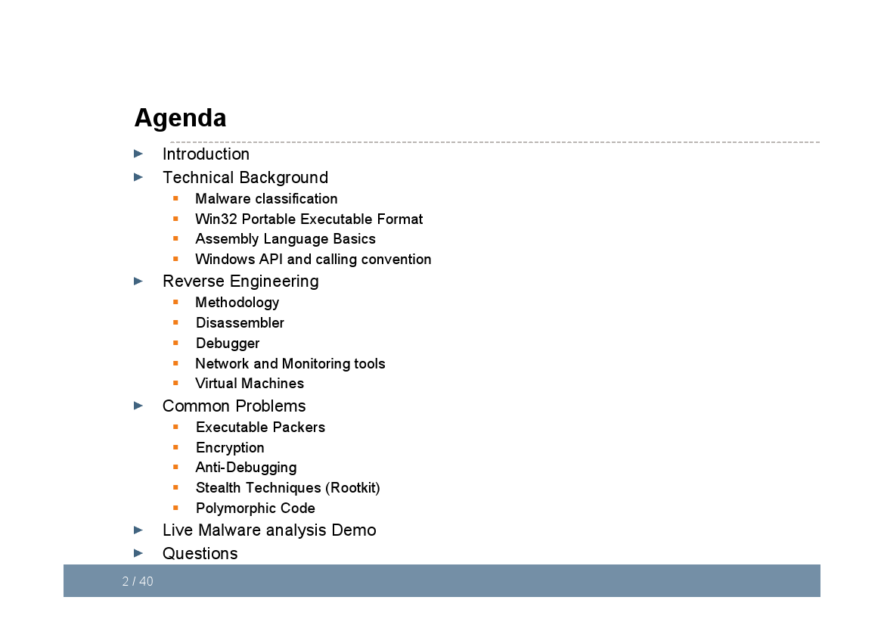

Slide 4
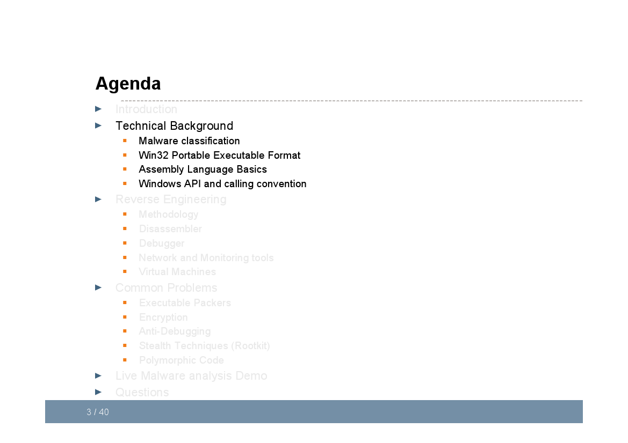

Slide 5
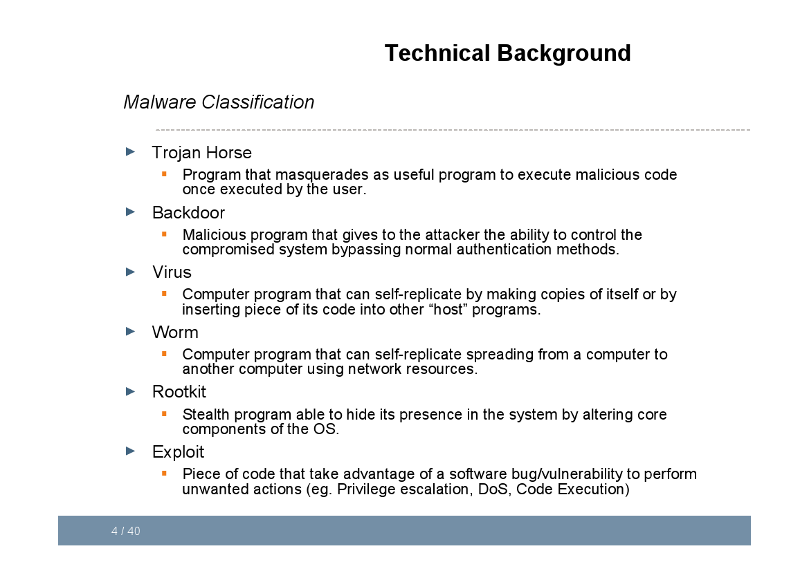

Slide 6
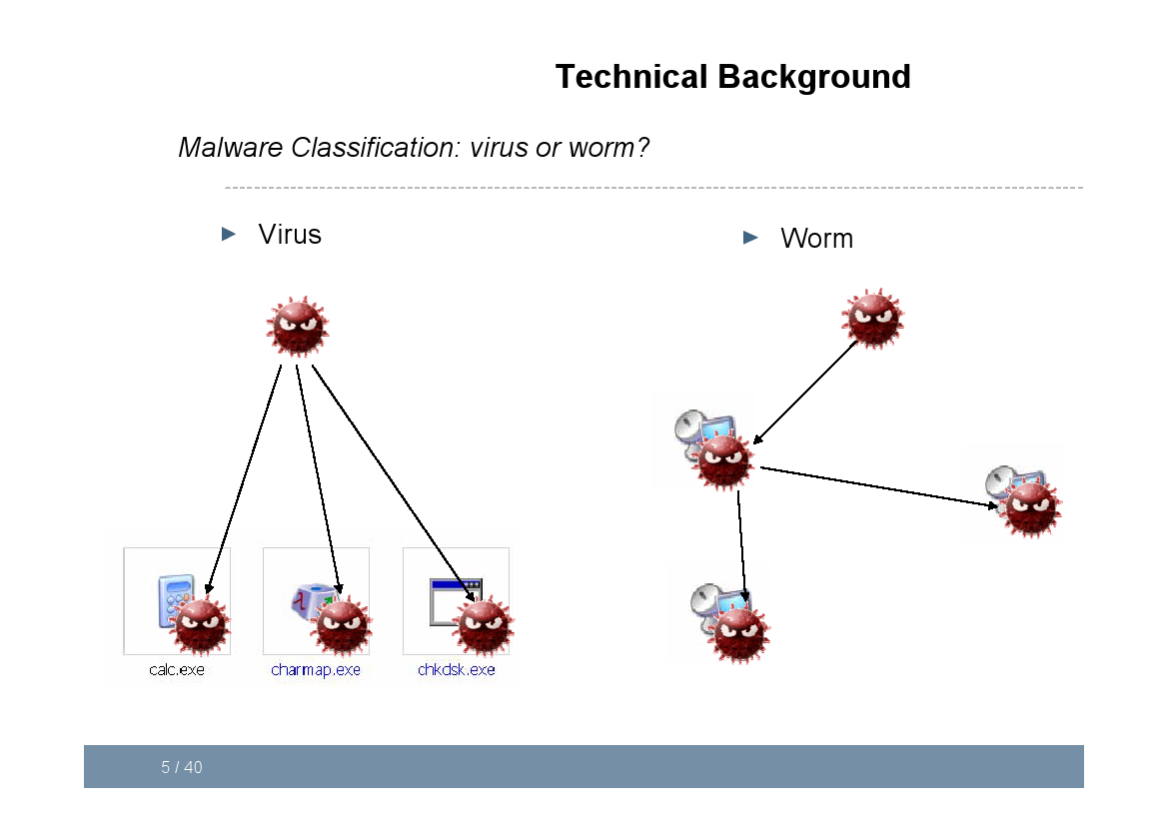

Slide 7
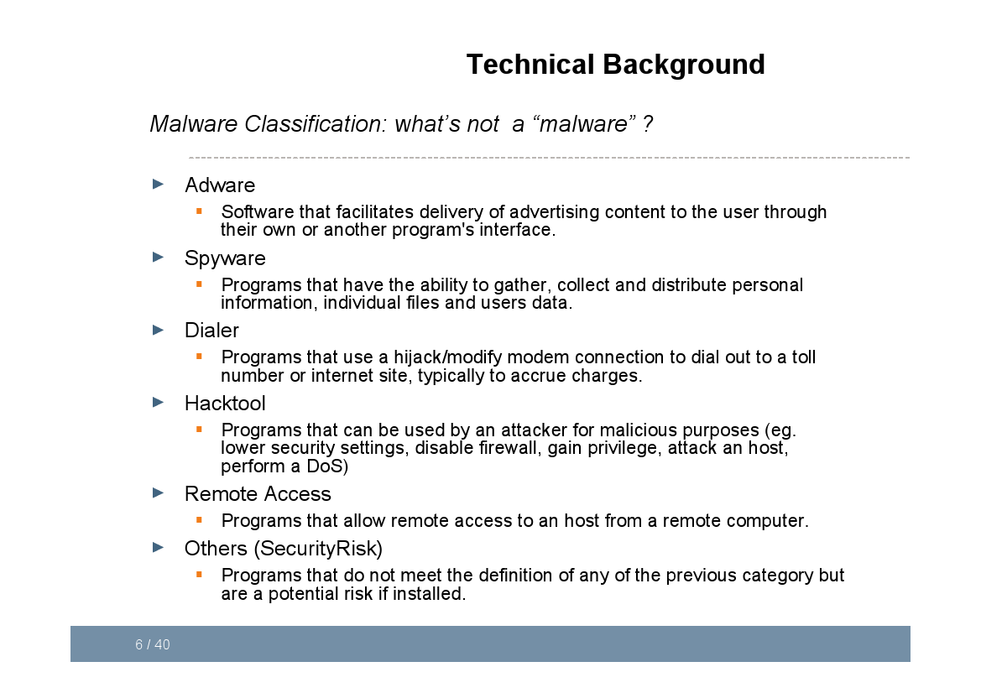

Slide 8
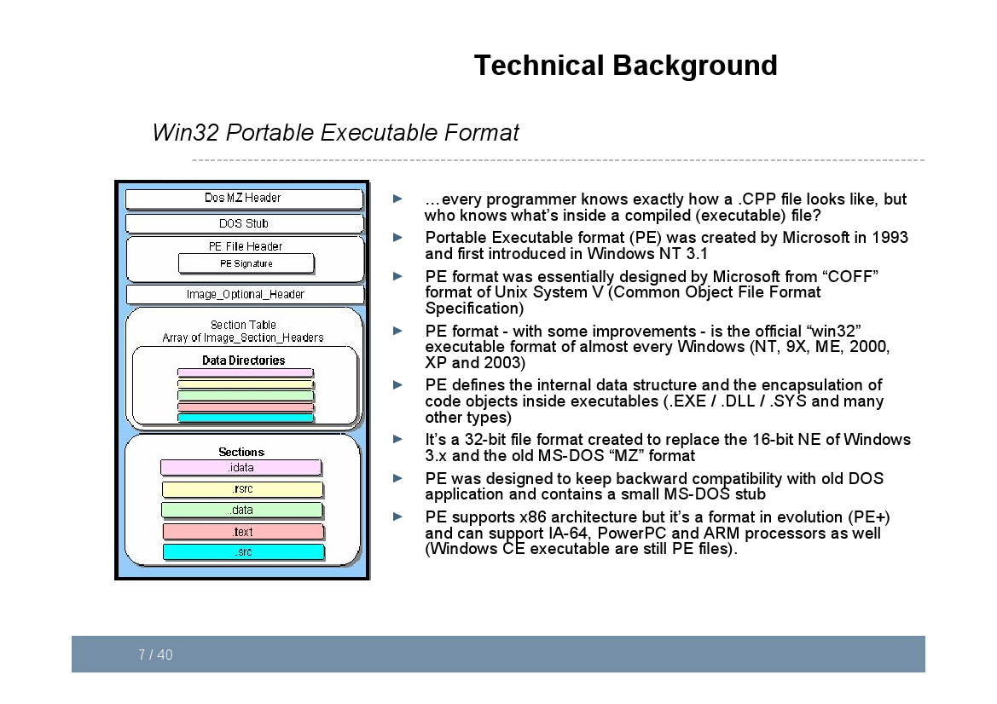

Slide 9
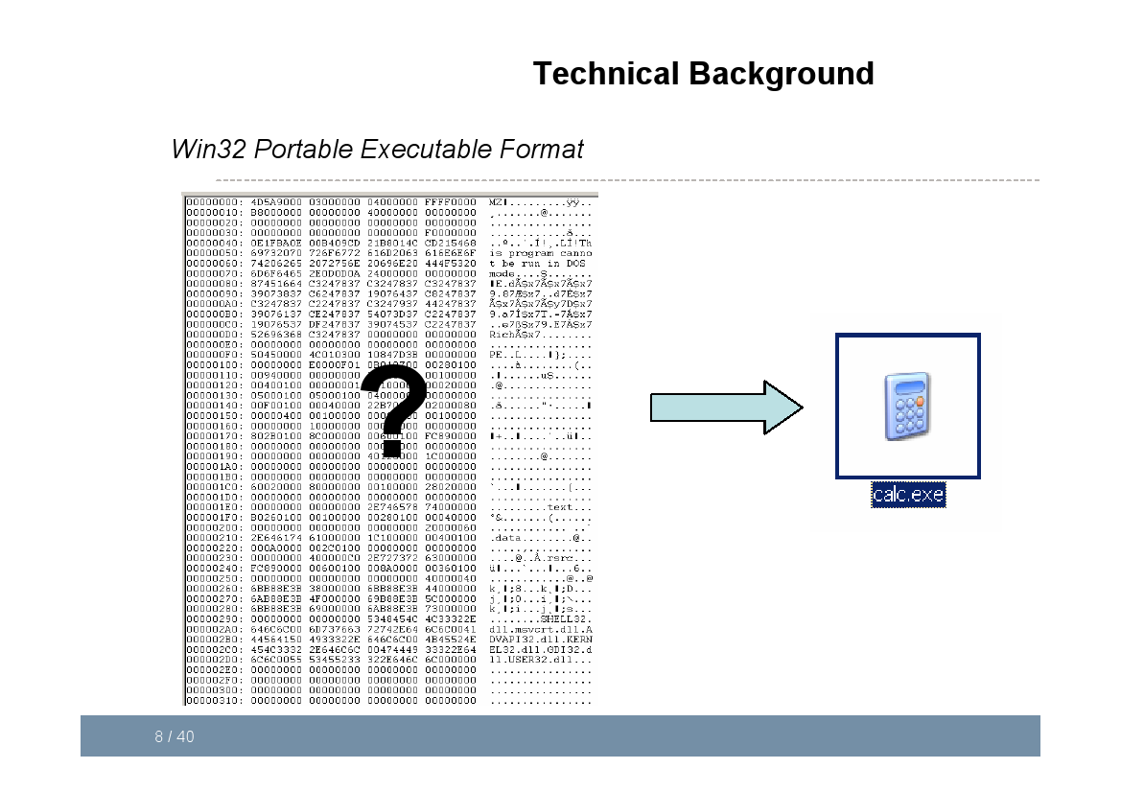

Slide 10
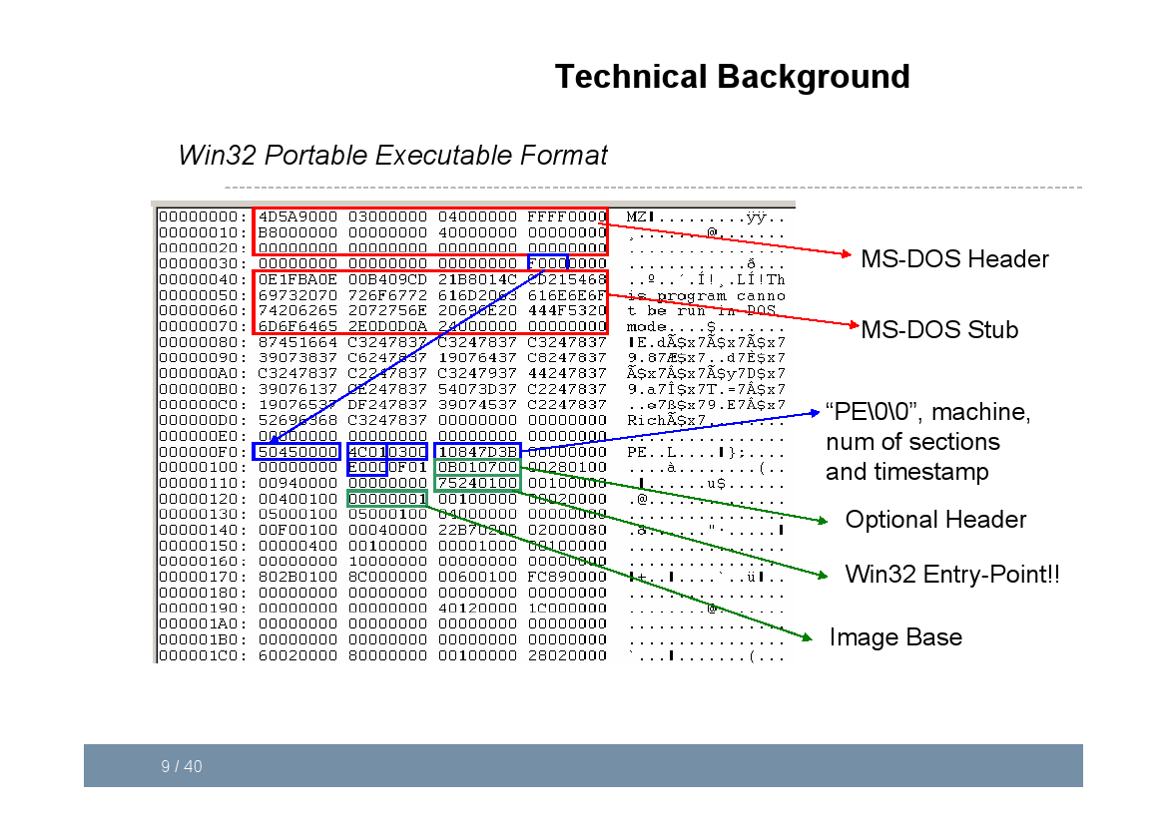

Slide 11
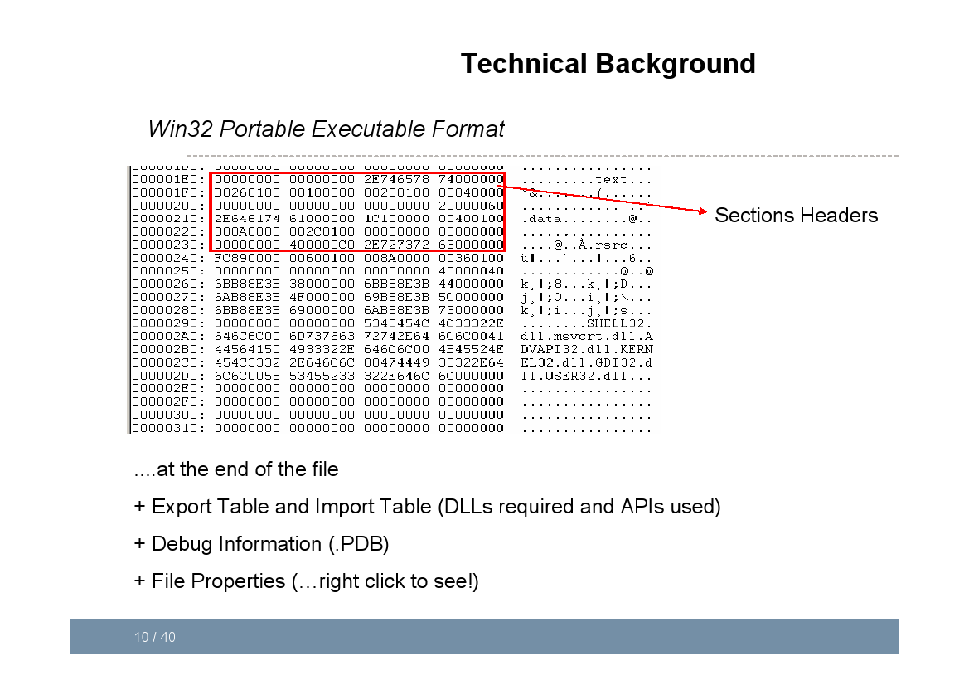

Slide 12
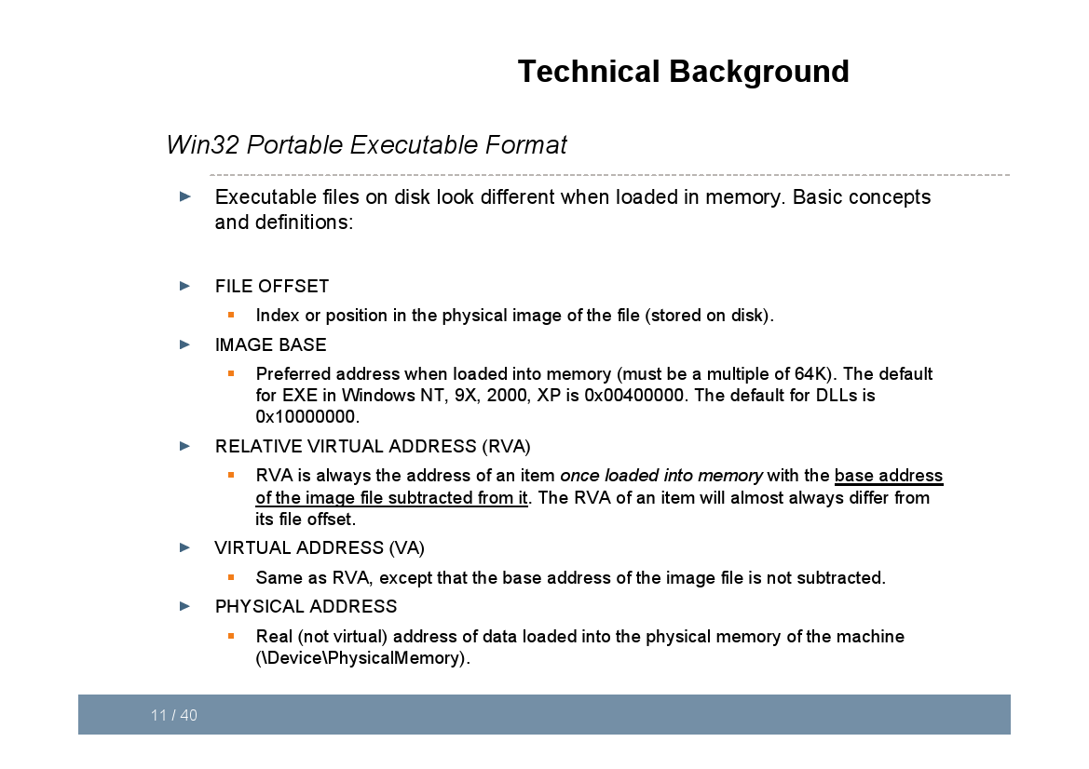

Slide 13
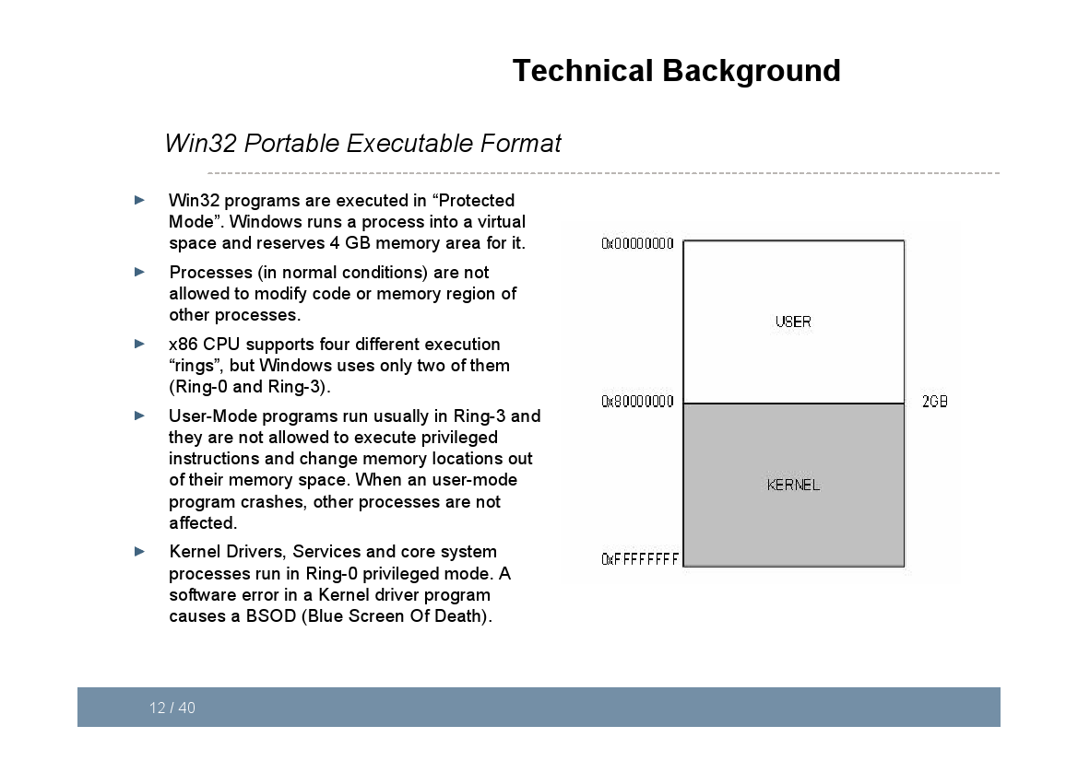

Slide 14
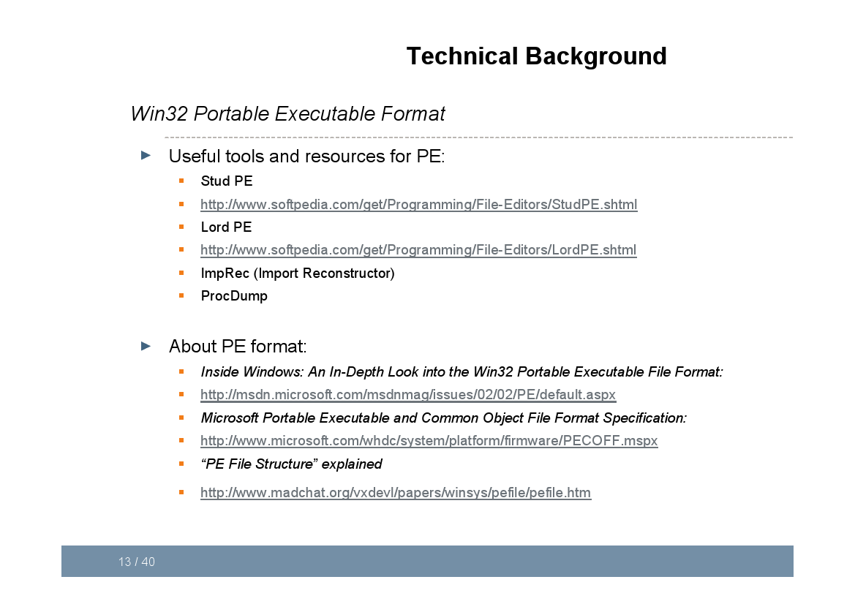

Slide 15
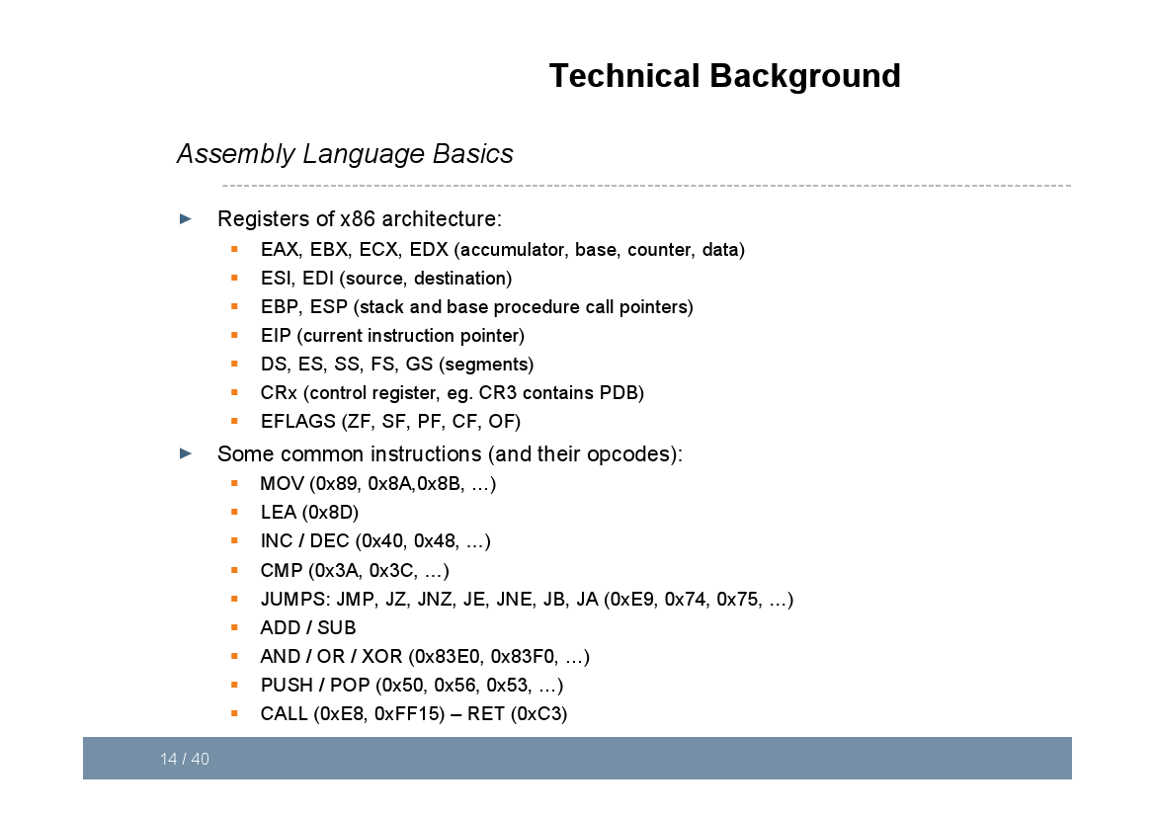

Slide 16
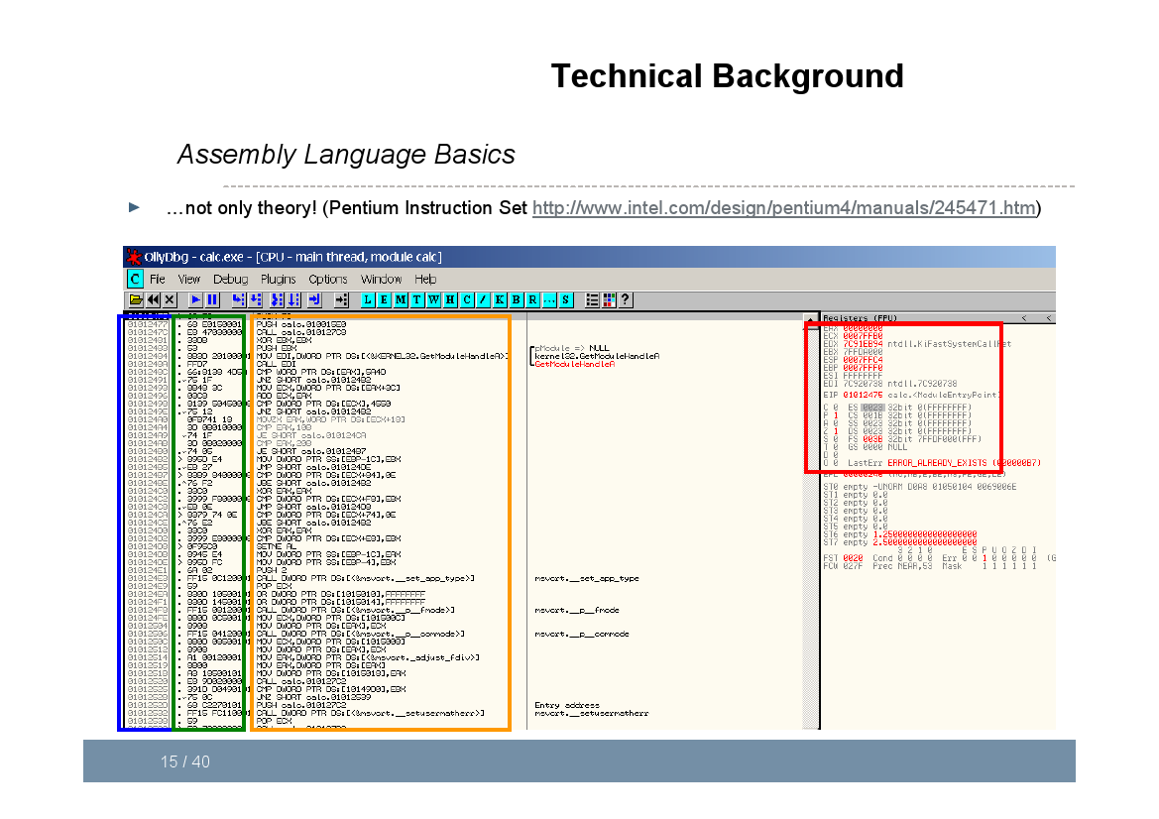

Slide 17
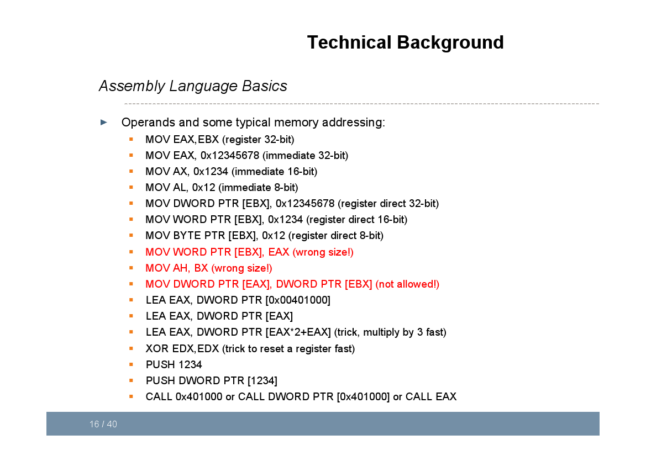

Slide 18
From 32 bit to 64
Eax→ rax
New registers: r8 .. r15

Slide 19
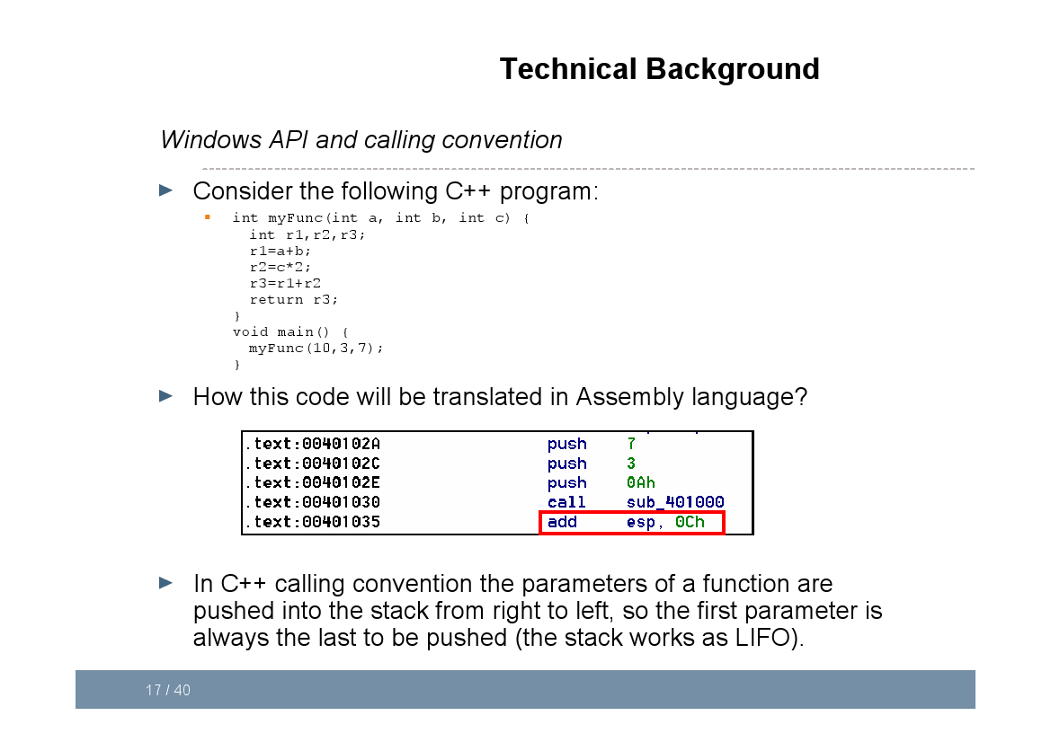

Slide 20
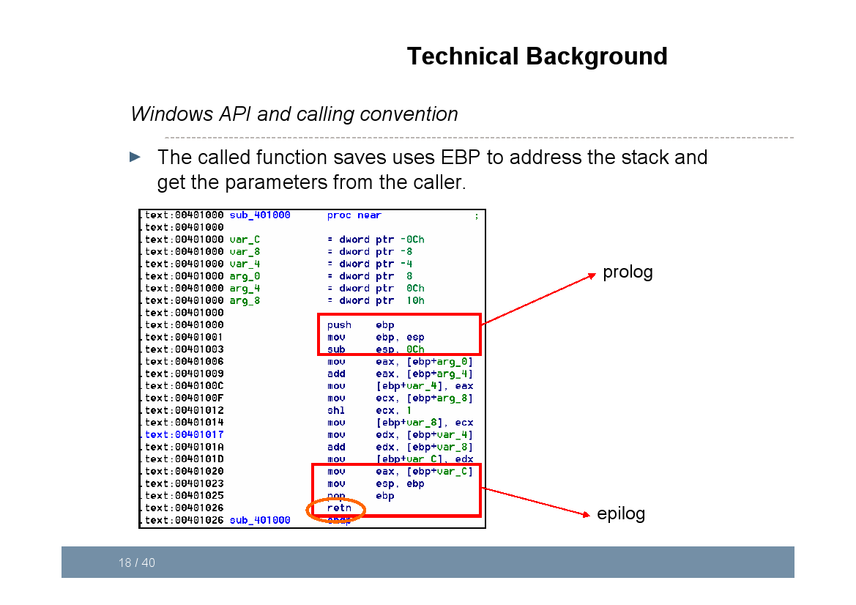

Slide 21
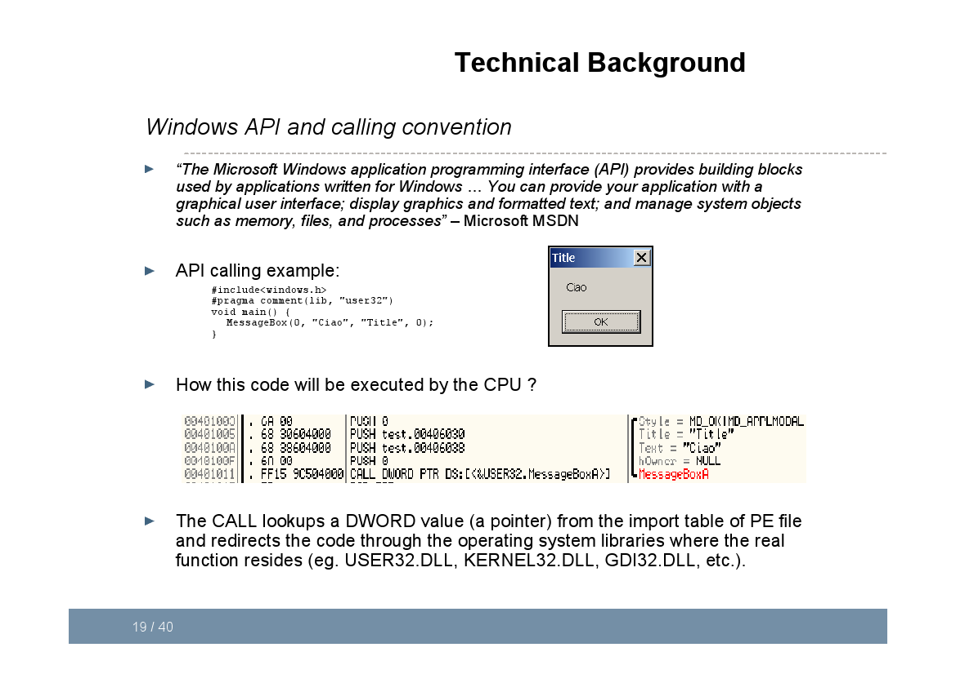

Slide 22
Buffer overflow

Slide 23
What is Buffer Overflow
Summary
Stack overflow

Slide 24
CounterMeasureS
Summary
ASLR
DEP
Last frontier of attacks: Return Oriented Programming

Slide 25
Run-Time Checking: StackGuard
Embed “canaries” (stack cookies) in stack frames and verify their integrity prior to function return
Any overflow of local variables will damage the canary
Choose random canary string on program start
Attacker can’t guess what the value of canary will be
Terminator canary: “\0”, newline, linefeed, EOF
String functions like strcpy won’t copy beyond “\0”
buf
canary
sfp
ret
addr
Frame of the
calling function
Top of
stack
Local variables
Pointer to
previous
frame
Return
execution to
this address

Slide 26
Defeating StackGuard
Suppose program contains strcpy(dst,buf) where attacker controls both dst and buf
Example: dst is a local pointer variable
buf
dst
canary
sfp
RET
Return execution to
this address
BadPointer, attack code
&RET
canary
sfp
RET
Overwrite destination of strcpy with RET position
strcpy will copy
BadPointer here

Slide 27
Online Memory Debugging
Cheat Engine
http://armorgames.com/play/12141/kingdom-rush

Slide 28
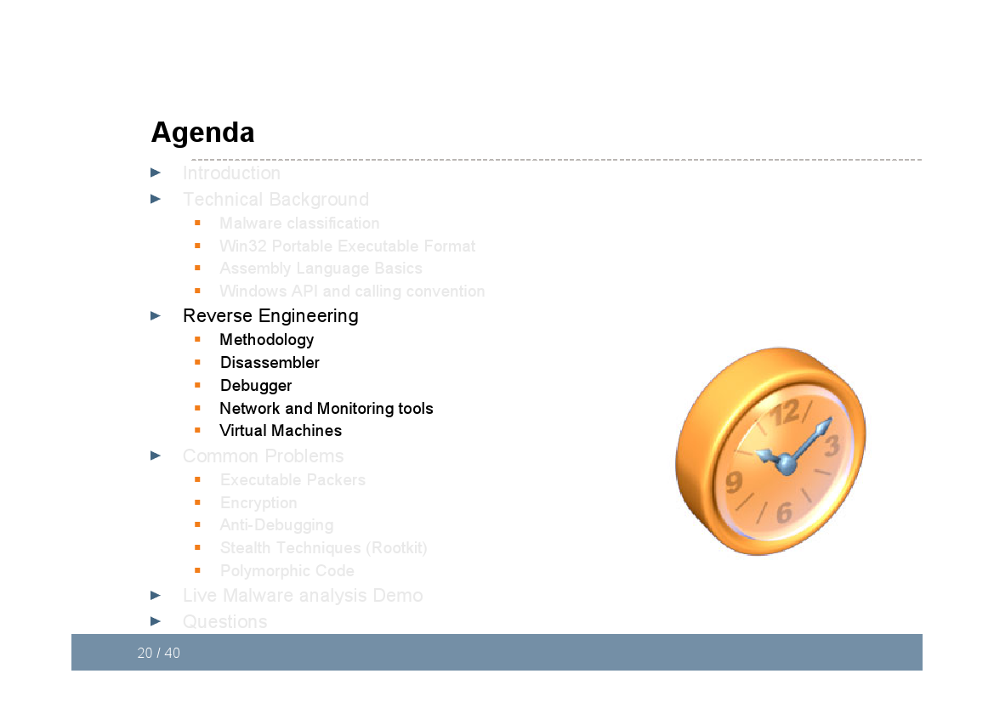

Slide 29
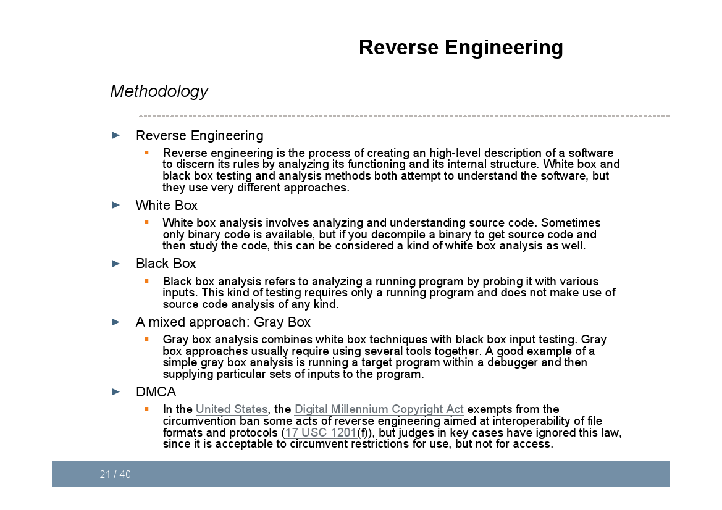

Slide 30
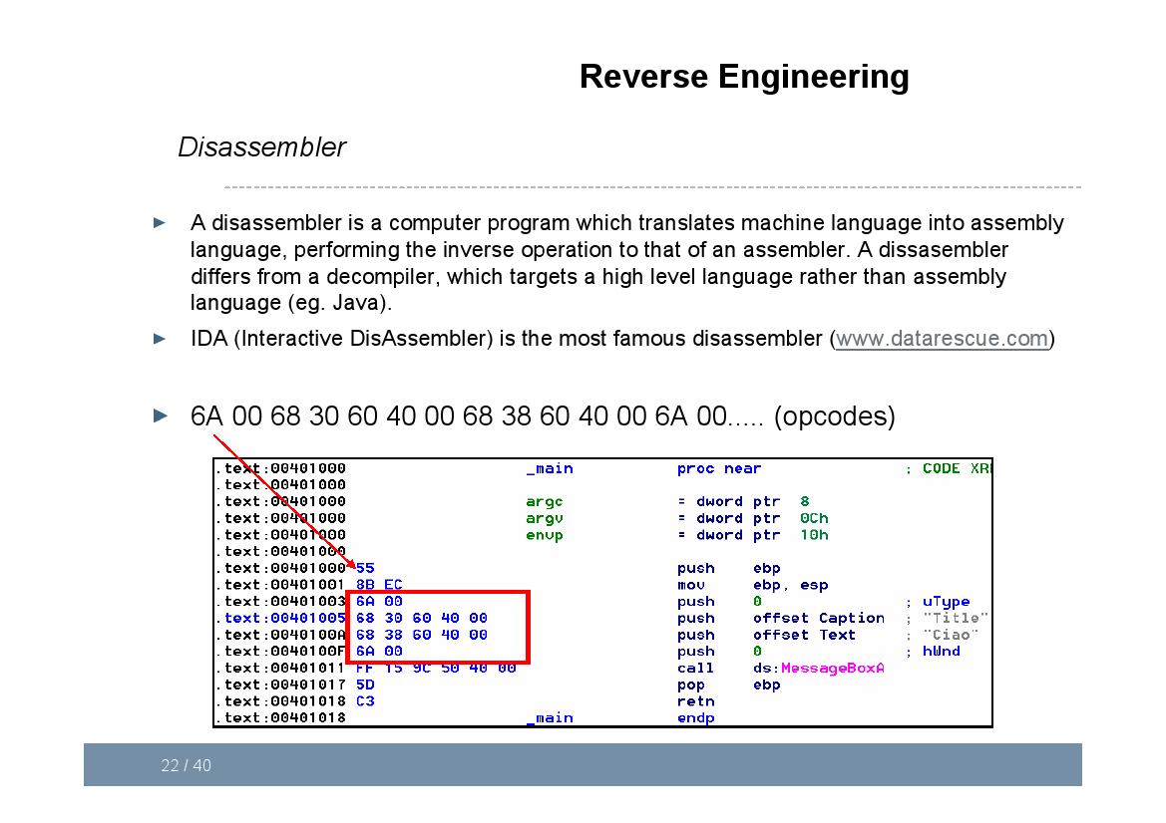

Slide 31
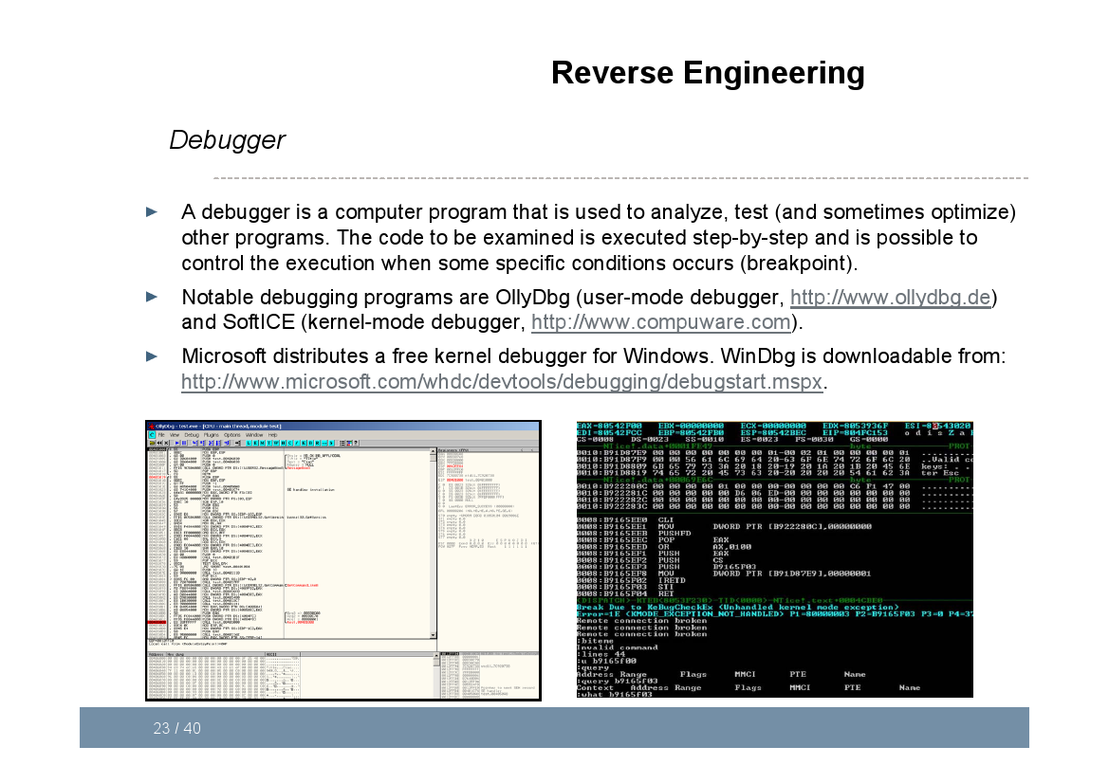

Slide 32
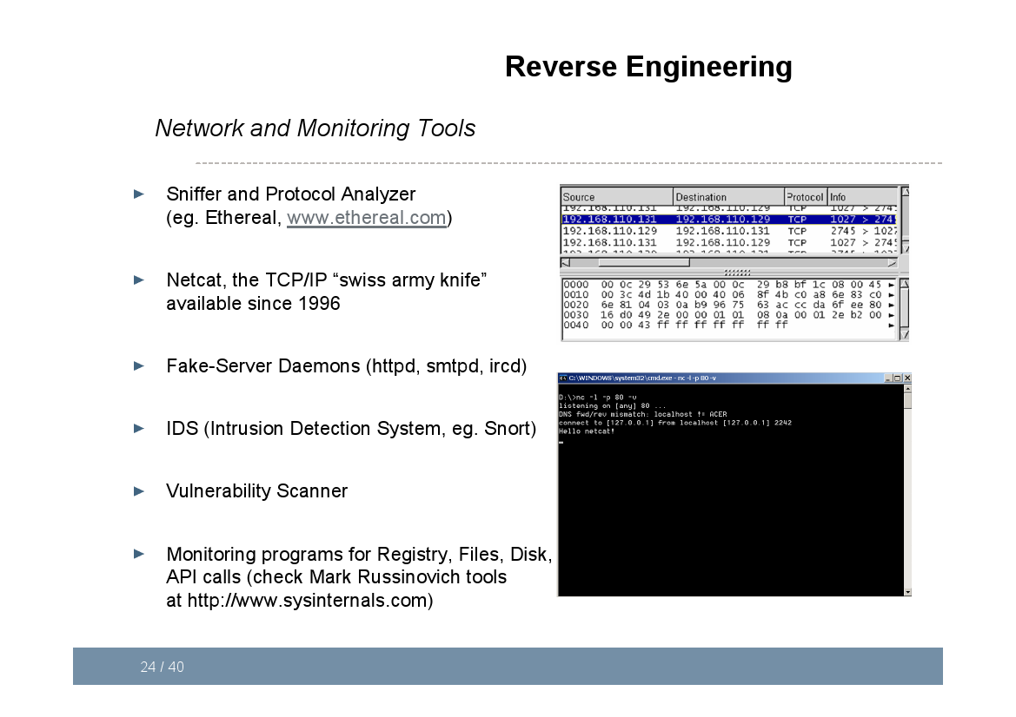

Slide 33
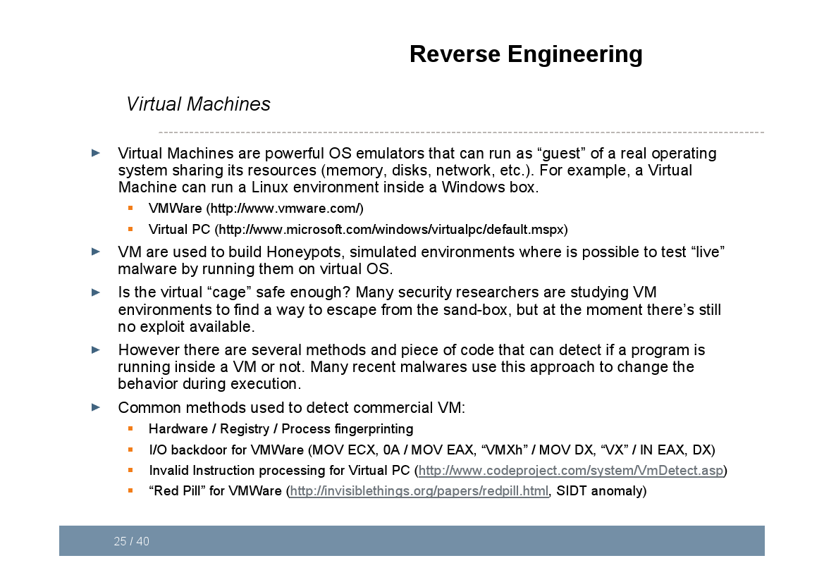

Slide 34
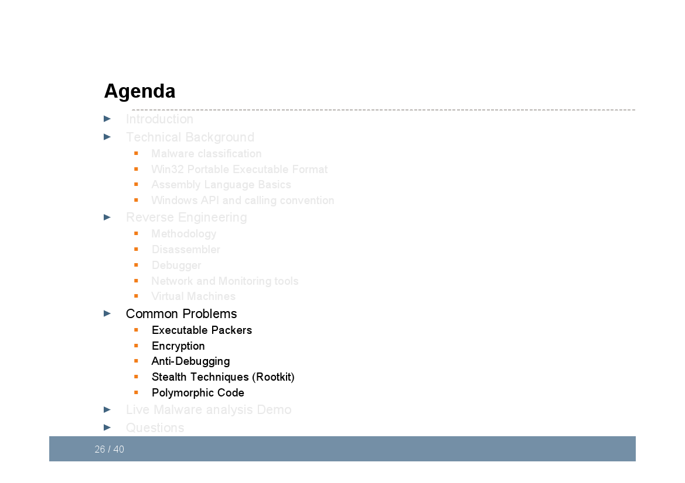

Slide 35
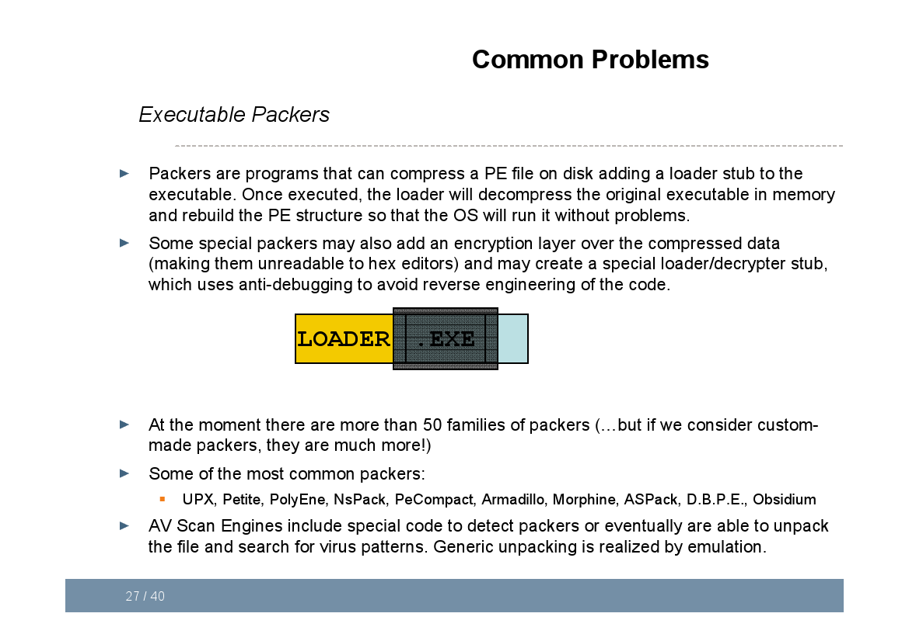

Slide 36
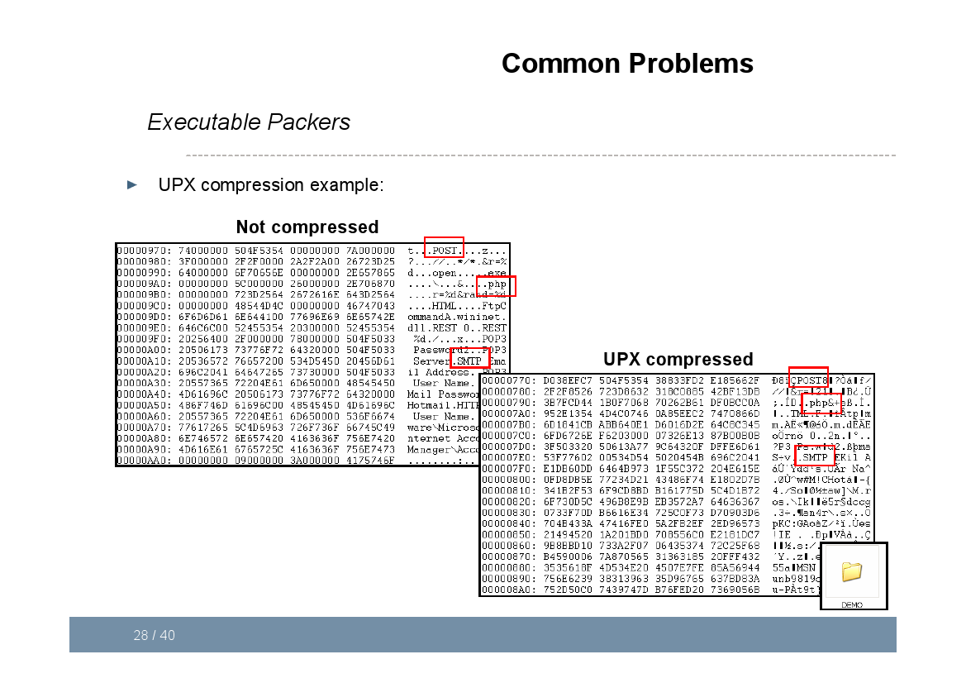

Slide 37
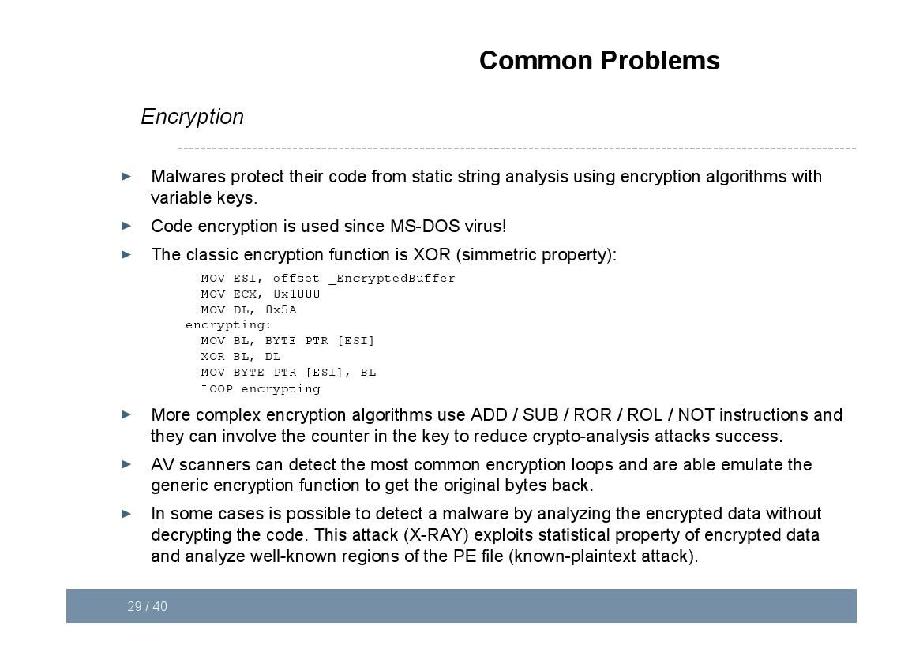

Slide 38
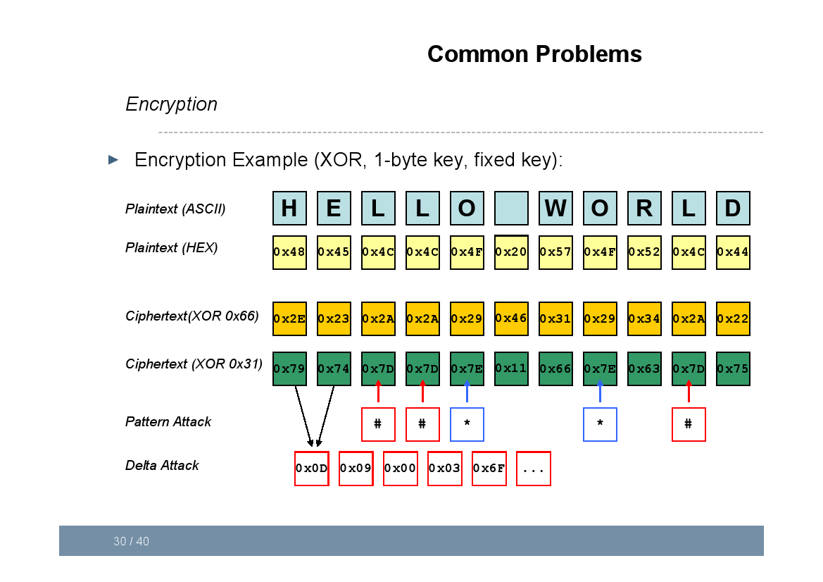

Slide 39
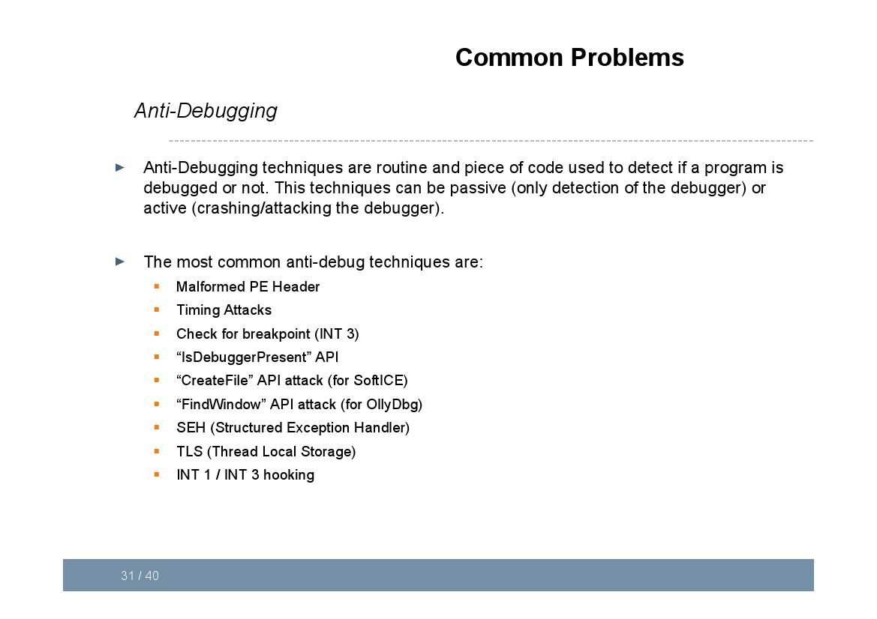

Slide 40
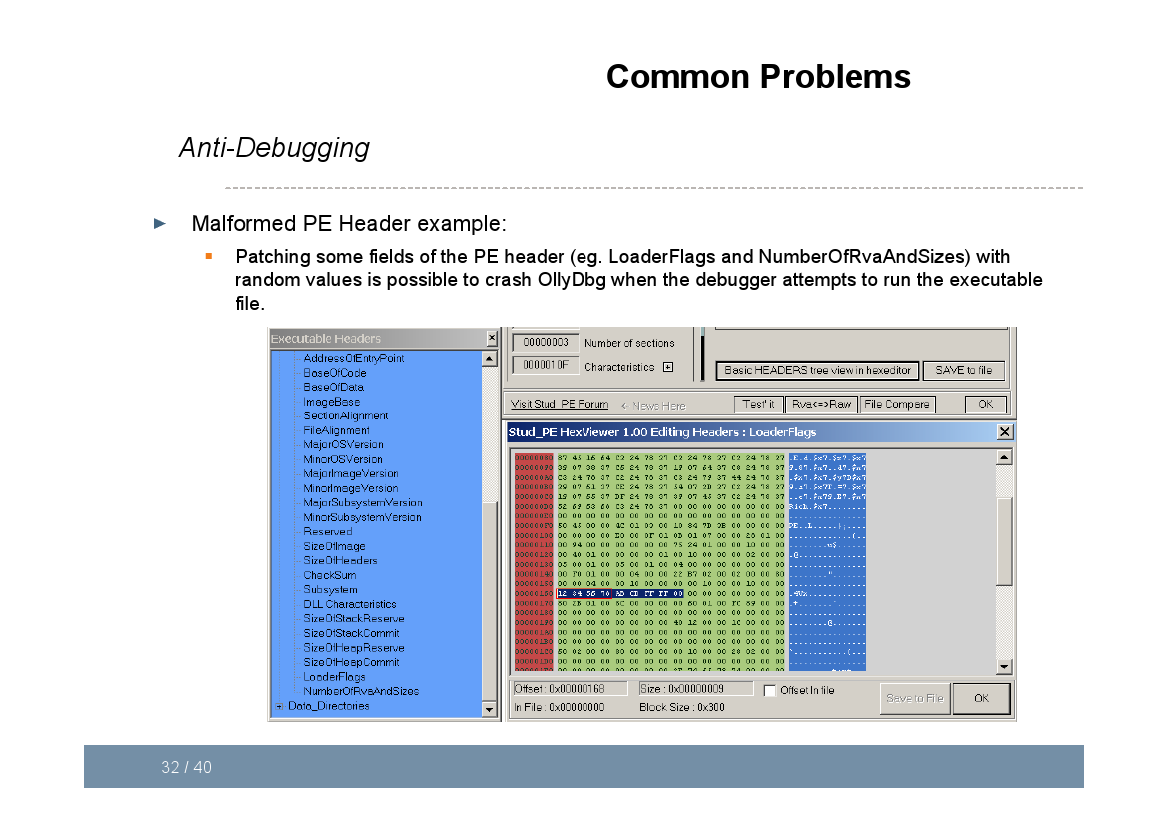

Slide 41
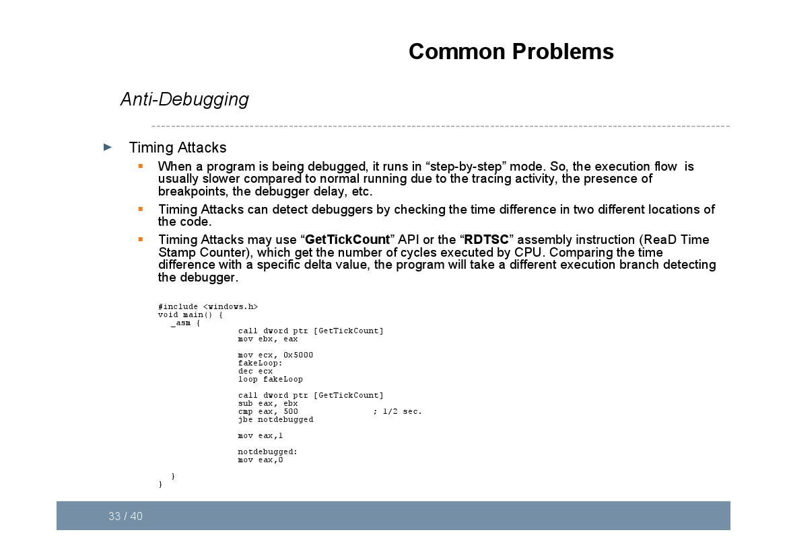

Slide 42
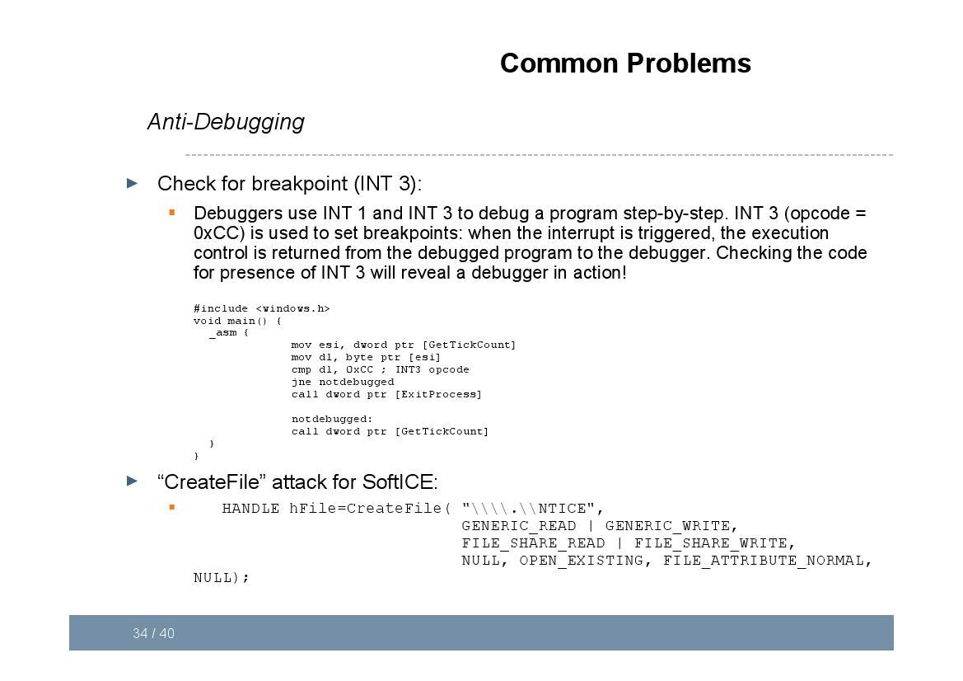

Slide 43
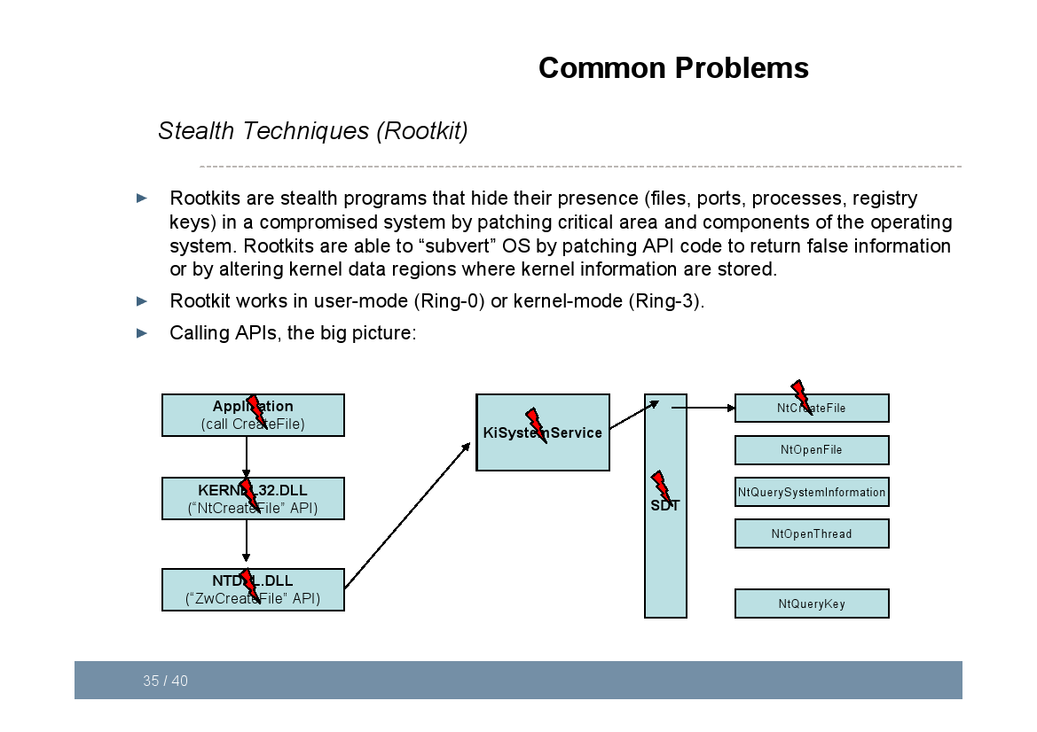

Slide 44
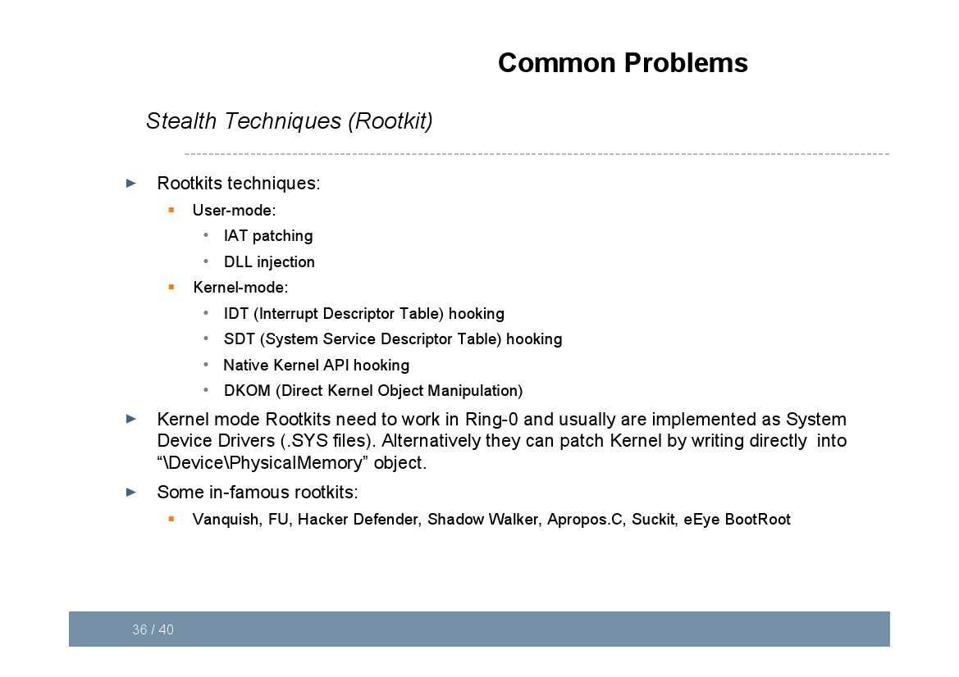

Slide 45
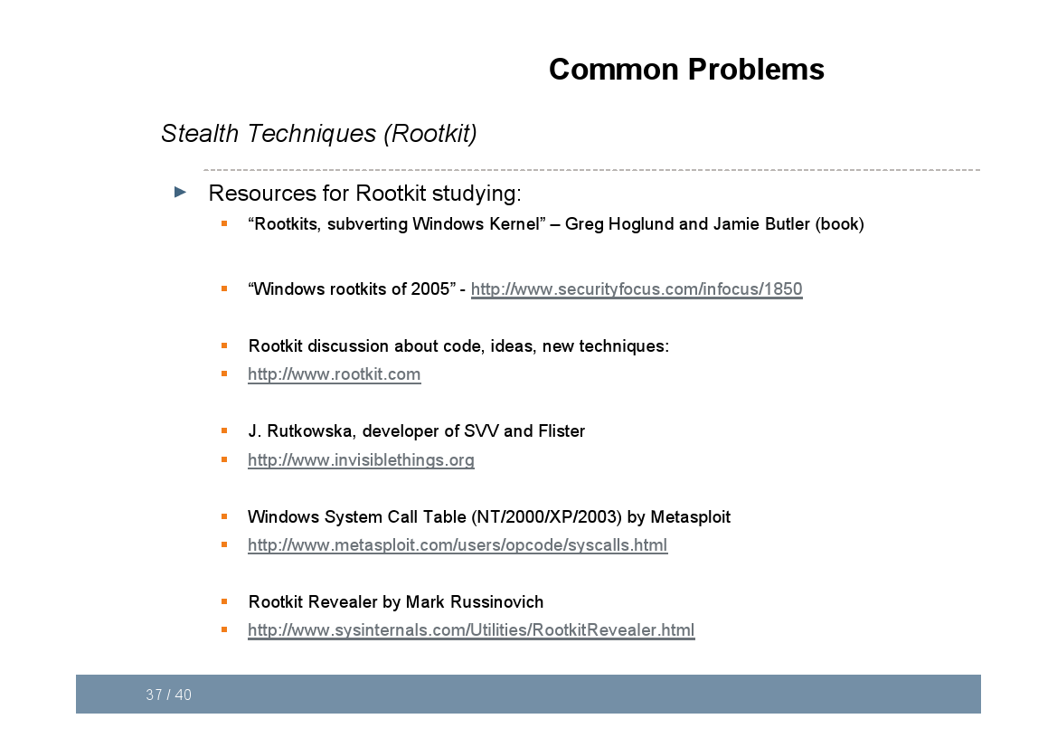

Slide 46
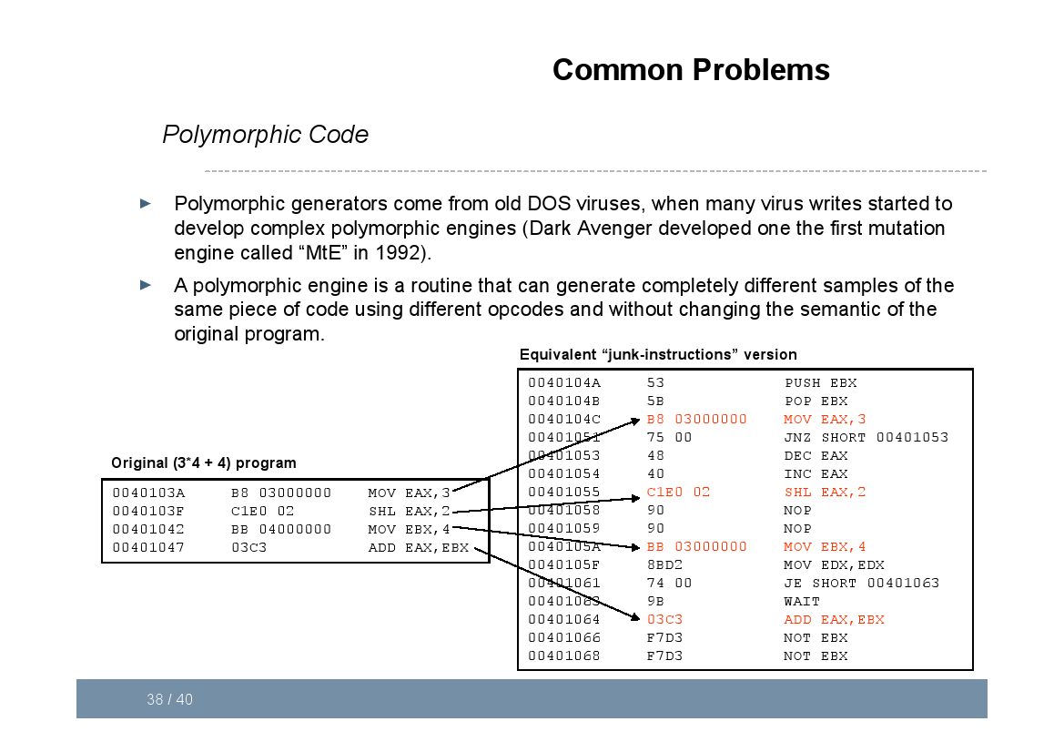

Slide 47
